Slide 1
Part 2.7: Orbital Diagrams

Slide 2
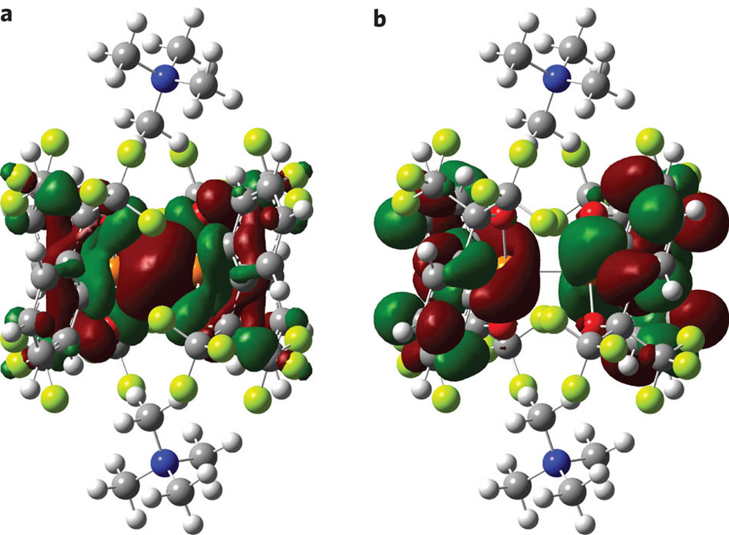
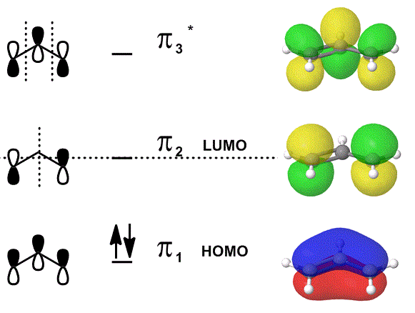
Orbital Diagrams
Orbital Interactions
Molecular Orbital Theory
Orbital Energies
MO Diagrams
HF, H₂O, CO₂, C₂H₄, NH₃, Benzene
SALC
Hybridization
Symmetry and Reactivity

Slide 3
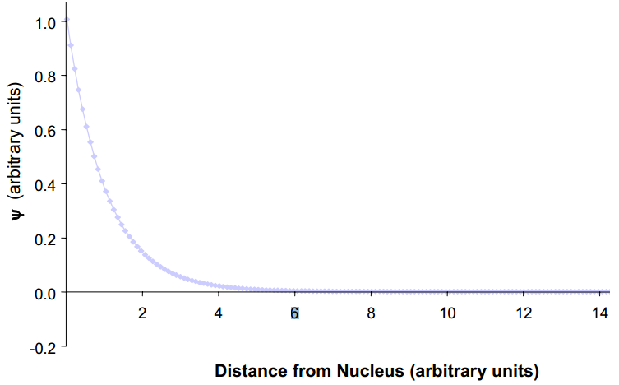
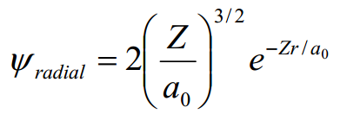

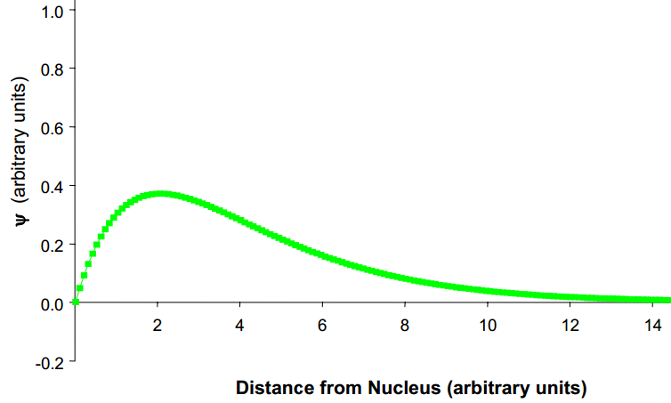
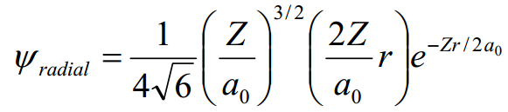

Atomic Orbitals
Atomic Orbital- is a mathematical function (Ψ) that describes the wave-like behavior of electrons in an atom.
Used to calculate the probability (Ψ² ) of finding any electron of an atom in any specific region around the atom's nucleus.
1s orbital
2p orbital

Slide 4
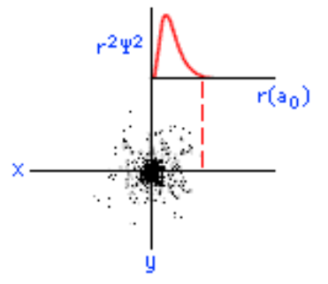
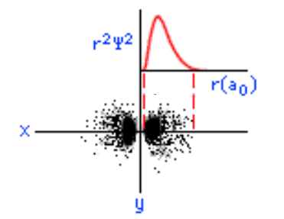
Atomic Orbitals
Atomic Orbital- is a mathematical function (Ψ) that describes the wave-like behavior of electrons in an atom.
Used to calculate the probability (Ψ² ) of finding any electron of an atom in any specific region around the atom's nucleus.
1s orbital
2p orbital

Slide 5
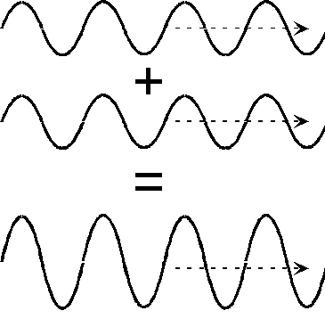
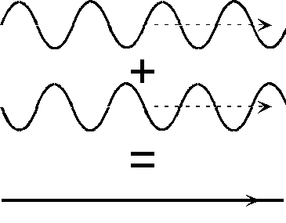

Atomic Orbitals
Atomic Orbital- is a mathematical function (Ψ) that describes the wave-like behavior of electrons in an atom.
Used to calculate the probability (Ψ² ) of finding any electron of an atom in any specific region around the atom's nucleus.
Waves can interact-
constructively = bonding
destructively = antibonding
not at all = non-bonding

Slide 6
Molecular Orbital Theory
ATOMIC ORBITALS of different atoms combine to create MOLECULAR ORBITALS
The number of ATOMIC ORBITALS = the number of MOLECULAR ORBITALS
Electrons in these MOLECULAR ORBITALS are shared by the molecule as whole
MOLECULAR ORBITALS can be constructed from Linear Combination of Atomic Orbitals (LCAO)
LCAO
Ψ = c_{a}ψ_{a} + c_{b}ψ_{b} (for diatomic molecules)
BONDING Orbitals have most of the electron density between the two nuclei
ANTI-BONDING Orbitals have a node between the two nuclei
NONBONDING Orbitals are essentially the same as if it was only one nuclei

Slide 7
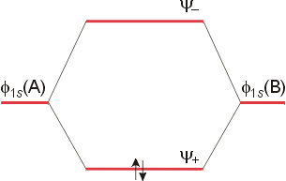
Combining Atomic Orbitals
Bonding:
Ψ_{(σ)} or Ψ₊ = (1/√2 ) [φ_{(1sa)} + φ_{(1sb)} ]
Antibonding:
Ψ_{(σ*)} or Ψ₋ = (1/√2 ) [φ_{(1sa)} - φ_{(1sb)} ]

Slide 8
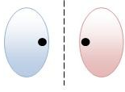
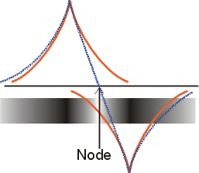

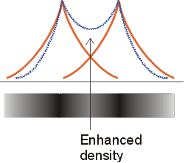

Combining Atomic Orbitals (H₂)
Antibonding
Bonding

Slide 9
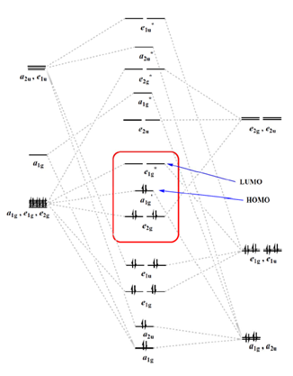


Combining Atomic Orbitals
H₂
Fe(C₅H₅)₂
2 atoms
Only s orbitals
Linear interaction
Same energy
Uniform symmetry
11 relevant atoms
s, p, and d orbitals
various interactions
different energies

Slide 10
Combining Atomic Orbitals
Ψ = c_{a}ψ_{a} + c_{b}ψ_{b} … c_{n}ψ_{n}
Degree of orbital overlap/mixing depends on:
Energy of the orbitals
The closer the energy, the more mixing.
Spatial proximity
The atoms must be close enough that there is reasonable
orbital overlap.
Symmetry
Atomic orbitals mix if they have similar symmetries.
Strength of the bond depends upon the degree of orbital overlap.

Slide 11
Energy of the Orbitals
For heteronuclear molecules:
1. The bonding orbital(s) will reside predominantly on the atom of lower orbital energy (the more electronegative atom).
2. The anti-bonding orbital(s) will reside predominantly on the atom with greater orbital energy (the less electronegative atom).
How do we determine orbital energies?

Slide 12
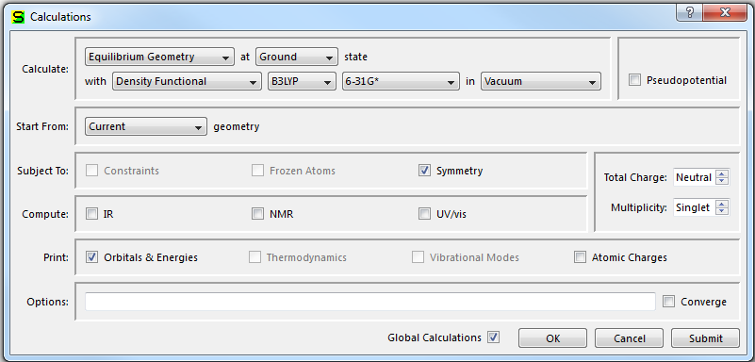
Energy of Orbitals
Theoretical calculations
Photoelectron spectroscopy
Tabulated data
Other peoples UPS/XPS data

Slide 13
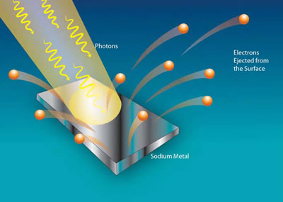
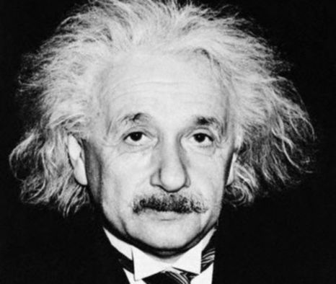
Photoelectron Spectroscopy
Ionization occurs when matter interacts with light of sufficient energy (Heinrich Hertz, 1886) (Einstein, A. Ann. Phys. Leipzig 1905, 17, 132-148.)

Slide 14
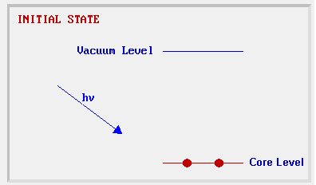
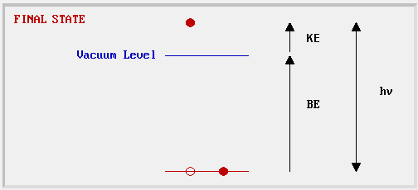
Photoelectron Spectroscopy
Photo-ionization and energy-dispersive analysis of the emitted photoelectrons to study the composition and electronic state of the sample.
hν_{o} = I(BE) + E_{kinetic}
X-ray Photoelectron Spectroscopy (XPS) | - using soft (200-2000 eV) x-ray excitation to examine core-levels.
Ultraviolet Photoelectron Spectroscopy (UPS) | - using vacuum UV (10-45 eV) radiation from discharge lamps to examine valence levels.

Slide 15
Photoelectron Spectrometer
X-Ray source
Ion source
SIMS Analyzer
Detector
Axial Electron Gun
Sample introduction Chamber
Sample Holder
sample
CMA
Roughing Pump
Slits
Ion Pump

Slide 16
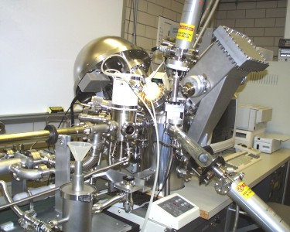
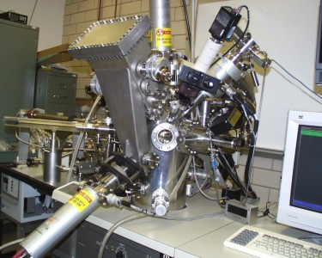
Photoelectron Spectrometer

Slide 17
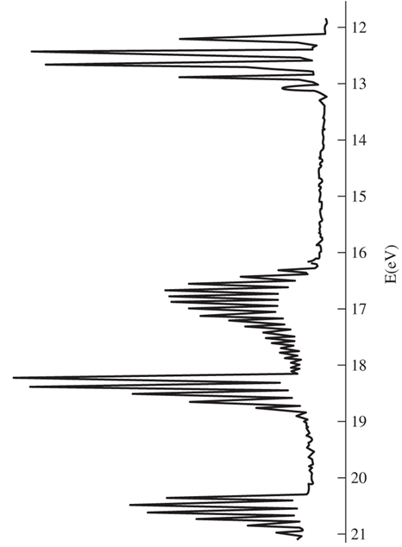
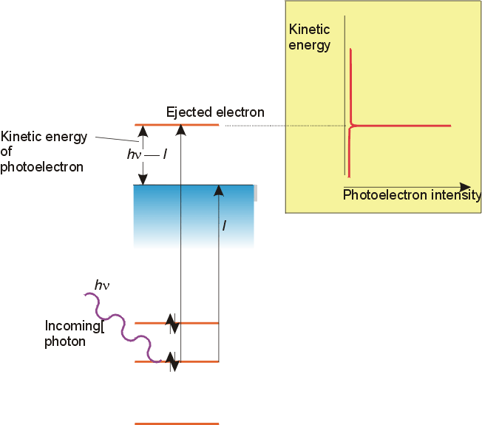
Photoelectron Spectroscopy
Counts

Slide 18
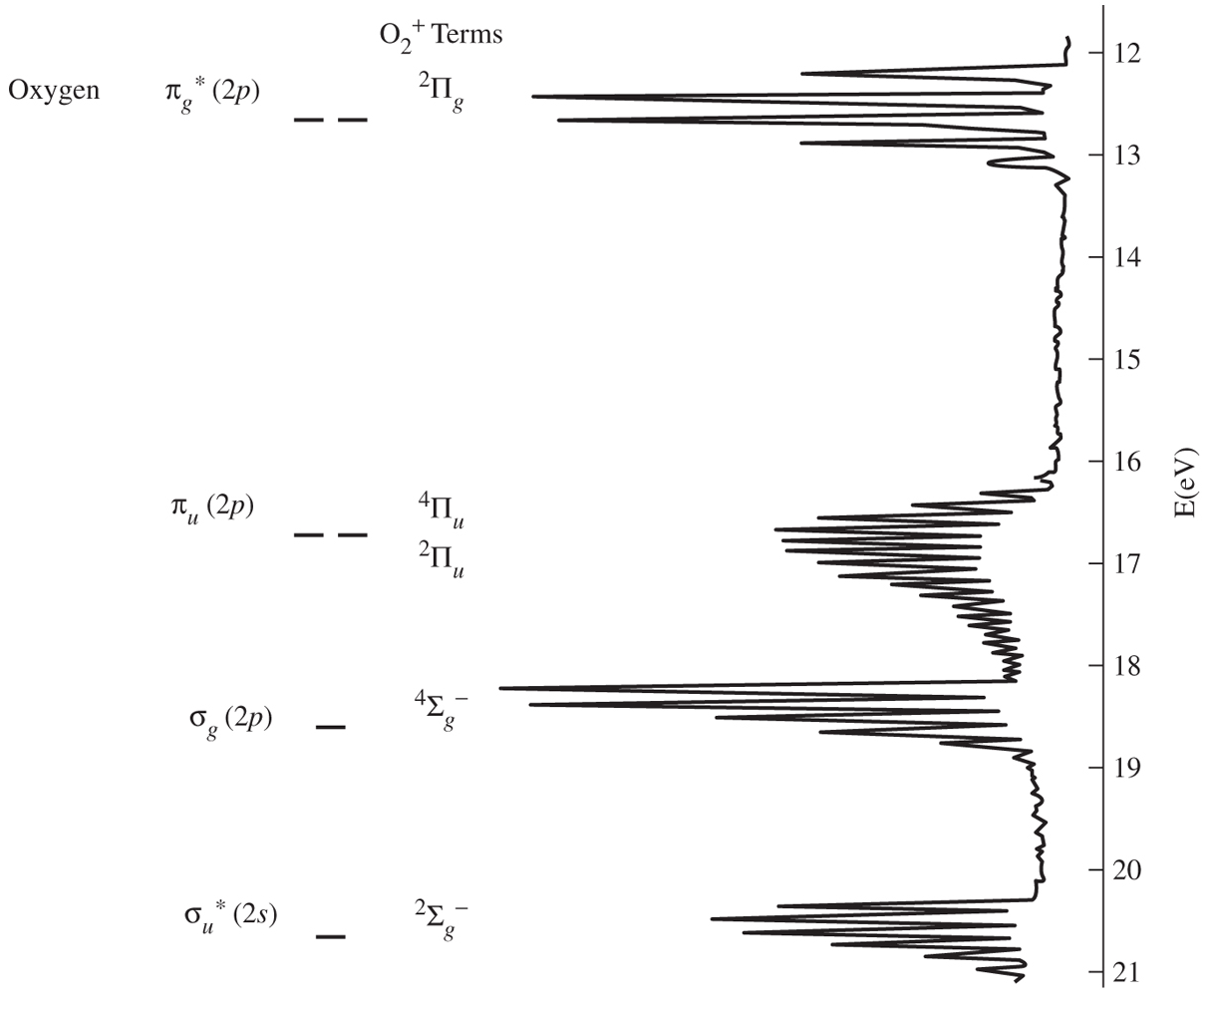
Photoelectron Spectroscopy
Counts

Slide 20
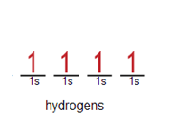
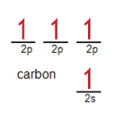
Tabulated Data
Miessler and Tarr, Inorganic Chemistry
Diagram for methane (CH₄)?

Slide 21
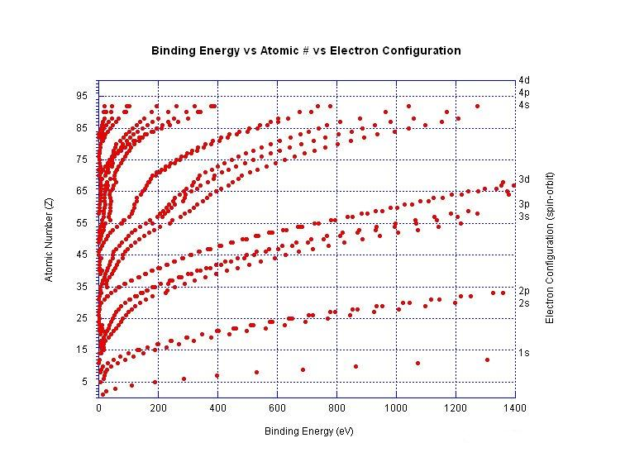
Tabulated Data
http://en.wikipedia.org/wiki/Ionization_energy

Slide 22
Combining Atomic Orbitals
Ψ = c_{a}ψ_{a} + c_{b}ψ_{b} … c_{n}ψ_{n}
Degree of orbital overlap/mixing depends on:
Energy of the orbitals
The closer the energy, the more mixing.
Spatial proximity
The atoms must be close enough that there is reasonable
orbital overlap.
Symmetry
Atomic orbitals mix if they have similar symmetries.
Strength of the bond depends upon the degree of orbital overlap.

Slide 23
Symmetry and Orbital Diagrams
Number of MOs = number of incipient orbitals. This rule could be referred to as “the conservation of orbitals.”
Orbitals of the same symmetry mix.
Orbital interactions can be bonding, nonbonding or antibonding.
There are three basic types of orbital overlap: σ (end on interaction), π (side by side approach) and δ (off-axis approach).
Orbitals with the correct symmetry and most similar energy mix to the greatest extent.
J. Chem. Edu. 2004, 81, 997.

Slide 24
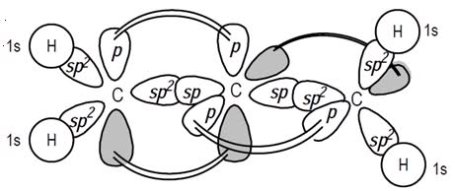
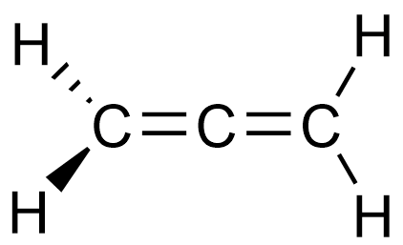
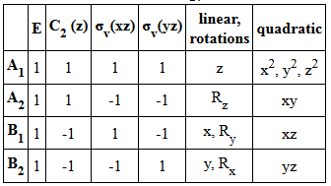
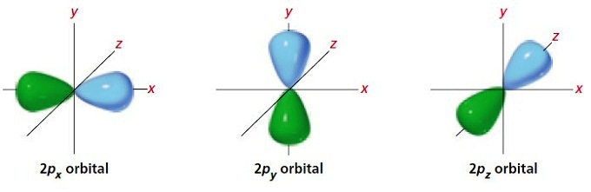
Constructing MOs
From inspection
From Group Theory

Slide 25


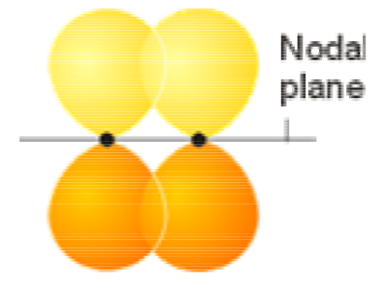
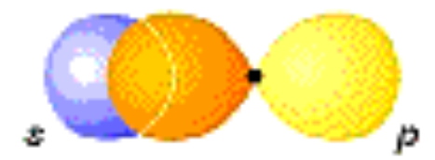
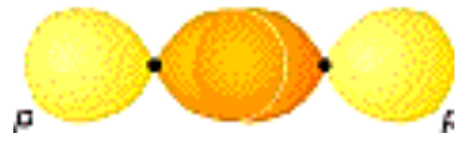

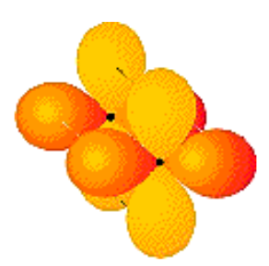
Constructing MOs
σ bond (s, p and d)
π bond (p and d)
p
p
p
d
δ bond (d)
d
d

Slide 26
Constructing MOs (s-s)

Slide 27
Constructing MOs (p-p)

Slide 28
Constructing MOs (d-d)

Slide 29
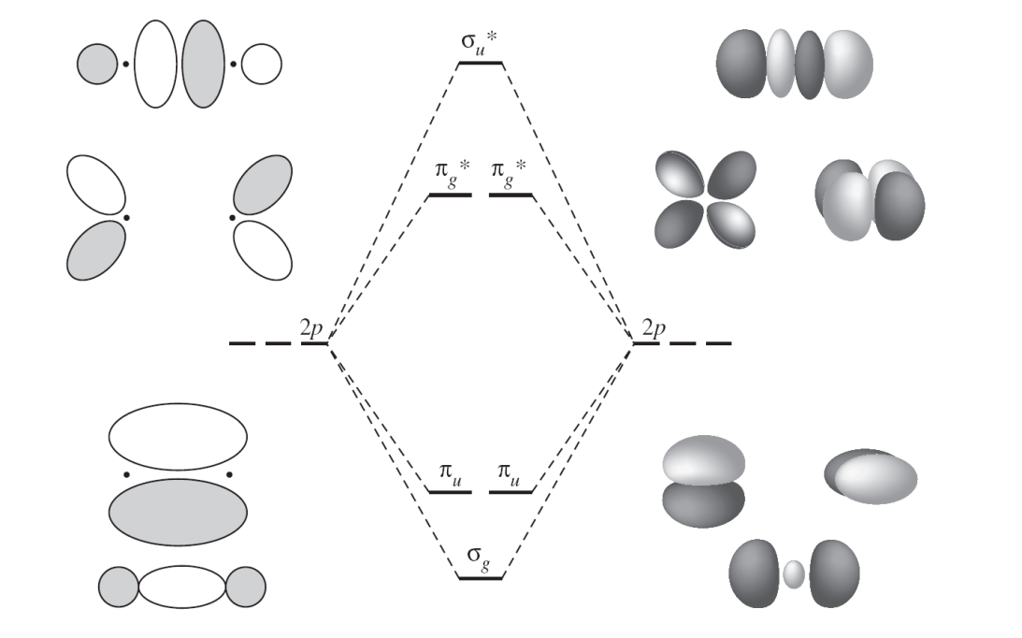
Simple Diatomics

Slide 30
MO Diagrams from Group Theory
Assign a point group
Choose basis function (orbitals)
Apply operations
-if the basis stays the same = +1
-if the basis is reversed = -1
-if it is a more complicated change = 0
Generate a reducible representation
Reduce to Irreducible Representation
Combine central and peripheral orbitals by their symmetry
Fill MOs with e⁻
Generate SALCs of peripheral atoms
Draw peripheral atoms SALC with central atom orbital to generate bonding/antibonding MOs.

Slide 31
MO Diagrams from Group Theory
H-F
diatomic, H = 1s; F = 2s, 3 x 2p
H₂O
triatomic, H = 2 x 1s; O = 2s, 3 x 2p
CO₂
π bonding, O = 2s, 3 x 2p; C = 2s, 3 x 2p
C₂H₄
Fragmentation method
Benzene
Real + Imaginary SALC

Slide 32
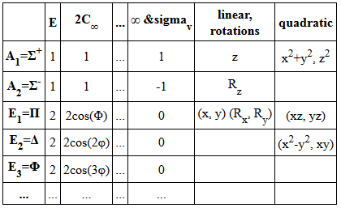
HF Orbital Diagram
Assign a point group
H-F
C_{2v}
C_{∞v}
C_{2v}

Slide 33
HF Orbital Diagram
Assign a point group
Choose basis function (orbitals)
Apply operations
-if the basis stays the same = +1
-if the basis is reversed = -1
-if it is a more complicated change = 0
H-F
C_{2v}
A₁
H s orbital
F s, p_{x}, p_{y} and p_{z} orbitals
z
F
x
y
H
1
1
1
1
Γ_{H}

Slide 34
HF Orbital Diagram
Assign a point group
Choose basis function (orbitals)
Apply operations
-if the basis stays the same = +1
-if the basis is reversed = -1
-if it is a more complicated change = 0
H-F
C_{2v}
A₁
H s orbital
F s, p_{x}, p_{y} and p_{z} orbitals
A₁
z
F
x
y
H
Γ_{Fs}
1
1
1
1

Slide 35
HF Orbital Diagram
Assign a point group
Choose basis function (orbitals)
Apply operations
-if the basis stays the same = +1
-if the basis is reversed = -1
-if it is a more complicated change = 0
H-F
C_{2v}
A₁
H s orbital
F s, p_{x}, p_{y} and p_{z} orbitals
A₁
A₁
z
F
x
y
H
Γ_{Fpz}
1
1
1
1

Slide 36
HF Orbital Diagram
Assign a point group
Choose basis function (orbitals)
Apply operations
-if the basis stays the same = +1
-if the basis is reversed = -1
-if it is a more complicated change = 0
H-F
C_{2v}
A₁
H s orbital
F s, p_{x}, p_{y} and p_{z} orbitals
A₁
B₁
A₁
z
F
x
y
H
Γ_{Fpx}
1
-1
1
-1

Slide 37
HF Orbital Diagram
Assign a point group
Choose basis function (orbitals)
Apply operations
-if the basis stays the same = +1
-if the basis is reversed = -1
-if it is a more complicated change = 0
H-F
C_{2v}
A₁
H s orbital
F s, p_{x}, p_{y} and p_{z} orbitals
A₁
B₁
B₂
A₁
z
F
x
y
H
Γ_{Fpy}
1
-1
-1
1

Slide 38
HF Orbital Diagram
Assign a point group
Choose basis function (orbitals)
Apply operations
-if the basis stays the same = +1
-if the basis is reversed = -1
-if it is a more complicated change = 0
Generate a reducible representation
Reduce to irreducible representation
Combine orbitals by their symmetry
H-F
C_{2v}
A₁
H s orbital
F s, p_{x}, p_{y} and p_{z} orbitals
A₁
B₁
B₂
A₁

Slide 39
HF Orbital Diagram
Combine orbitals by their symmetry
H s orbital
F s, p_{x}, p_{y} and p_{z} orbitals

Slide 40
HF Orbital Diagram
Combine orbitals by their symmetry
1s (A₁)
p_{z} (A₁)
p_{x} (B₁)
p_{y} (B₂)
2s (A₁)
H
H-F
F
A₁
H s orbital
F s, p_{x}, p_{y} and p_{z} orbitals
A₁
B₁
B₂
A₁

Slide 41
HF Orbital Diagram
Combine orbitals by their symmetry
A₁
1s (A₁)
p_{y} (B₂)
p_{x} (B₁)
p_{z} (A₁)
p_{x} (B₁)
p_{y} (B₂)
A₁
A₁
2s (A₁)
H
H-F
F

Slide 42
HF Orbital Diagram
Fill MOs with e⁻
A₁
1s (A₁)
p_{y} (B₂)
p_{x} (B₁)
p_{z} (A₁)
p_{x} (B₁)
p_{y} (B₂)
A₁
A₁
2s (A₁)
1 e⁻
H
H-F
F
7 e⁻

Slide 43
e⁻ in MOs
Electrons preferentially occupy molecular orbitals that are lower in energy. (Aufbau Principle)
If two electrons occupy the same molecular orbital, they must be spin paired. (Pauli Exclusion Principle)
When occupying degenerate molecular orbitals, electrons occupy separate orbitals with parallel spins before pairing. (Hund’s Rule)

Slide 44
HF Orbital Diagram
Fill MOs with e⁻
A₁
1s (A₁)
p_{y} (B₂)
p_{x} (B₁)
p_{z} (A₁)
p_{x} (B₁)
p_{y} (B₂)
A₁
A₁
2s (A₁)
H
H-F
F

Slide 45
HF Orbital Diagram
Assign a point group
Choose basis function (orbitals)
Apply operations
-if the basis stays the same = +1
-if the basis is reversed = -1
-if it is a more complicated change = 0
Generate a reducible representation
Reduce to irreducible representation
Combine orbitals by their symmetry
Fill MOs with e⁻
Generate SALCs of peripheral atoms
Draw peripheral atoms SALC with central atom orbital to generate bonding/antibonding MOs.
A₁
1s (A₁)
p_{y} (B₂)
p_{x} (B₁)
p_{z} (A₁)
p_{x} (B₁)
p_{y} (B₂)
A₁
A₁
2s (A₁)
H
H-F
F

Slide 46
HF Orbital Diagram
F
Draw orbitals
A₁
H
F
F
1s (A₁)
B₁
B₂
p_{z}
p_{x}
H
p_{y}
F
F
F
A₁
F
H
F
z
A₁
2s (A₁)
F
x
y
H-F
F
H

Slide 47

MO Diagrams from Group Theory
H-F
diatomic, H = 1s; F = 2s, 3 x 2p
H₂O
triatomic, H = 2 x 1s; O = 2s, 3 x 2p
CO₂
π bonding, O = 2s, 3 x 2p; C = 2s, 3 x 2p
C₂H₄
Fragmentation method
NH₃/Benzene
Real + Imaginary SALC

Slide 48
H₂O Orbital Diagram
Assign a point group
Choose basis function (orbitals)
Apply operations
-if the basis stays the same = +1
-if the basis is reversed = -1
-if it is a more complicated change = 0
H₂O
C_{2v}
A₁ + B₁
H s orbitals
O s, p_{x}, p_{y} and p_{z} orbitals
z
O
x
y
H
H
2
0
2
0
Γ_{H}
Γ_{H}
A₁ + B₁

Slide 49
H₂O Orbital Diagram
Assign a point group
Choose basis function (orbitals)
Apply operations
-if the basis stays the same = +1
-if the basis is reversed = -1
-if it is a more complicated change = 0
H₂O
C_{2v}
A₁ + B₁
H s orbitals
O s, p_{x}, p_{y} and p_{z} orbitals
A₁
B₁
B₂
A₁
z
O
x
y
H
H

Slide 50
H₂O Orbital Diagram
Assign a point group
Choose basis function (orbitals)
Apply operations
-if the basis stays the same = +1
-if the basis is reversed = -1
-if it is a more complicated change = 0
Generate a reducible representation
Reduce to irreducible representation
Combine orbitals by their symmetry
H₂O
C_{2v}
A₁ + B₁
H s orbitals
O s, p_{x}, p_{y} and p_{z} orbitals

Slide 51
HF Orbital Diagram
Combine orbitals by their symmetry
H s orbital
O s, p_{x}, p_{y} and p_{z} orbitals

Slide 52
H₂O Orbital Diagram
Combine orbitals by their symmetry
A₁ B₁
p_{z} (A₁)
p_{x} (B₁)
p_{y} (B₂)
A₁ + B₁
2s (A₁)
H s orbital
O s, p_{x}, p_{y} and p_{z} orbitals
2 x H
O
A₁
B₁
B₂
A₁

Slide 53
H₂O Orbital Diagram
Combine orbitals by their symmetry
B₁
A₁
A₁ B₁
p_{y} (B₂)
p_{z} (A₁)
p_{x} (B₁)
p_{y} (B₂)
A₁
B₁
2s (A₁)
A₁
2 x H
H₂O
O

Slide 54
H₂O Orbital Diagram
Fill MOs with e⁻
B₁
A₁
A₁ B₁
p_{y} (B₂)
p_{z} (A₁)
p_{x} (B₁)
p_{y} (B₂)
A₁
B₁
2s (A₁)
A₁
2 e⁻
2 x H
H₂O
O
6 e⁻

Slide 55
H₂O Orbital Diagram
Assign a point group
Choose basis function (orbitals)
Apply operations
-if the basis stays the same = +1
-if the basis is reversed = -1
-if it is a more complicated change = 0
Generate a reducible representation
Reduce to irreducible representation
Combine orbitals by their symmetry
Fill MOs with e⁻
Generate SALCs of peripheral atoms
Draw peripheral atoms SALC with central atom orbital to generate bonding/antibonding MOs.
B₁
A₁
A₁ B₁
p_{y} (B₁)
p_{z} (A₁)
p_{x} (B₁)
p_{y} (B₂)
A₁
B₁
2s (A₁)
A₁

Slide 56
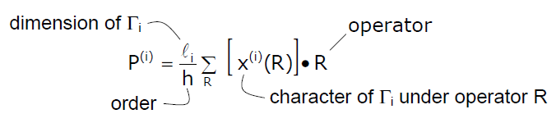
H₂O Orbital Diagram
Generate SALCs of peripheral atoms
Symmetry adapted linear combination of atomic orbitals (SALC)
Use projection operator to generate SALC.
Projection operators constitute a method of generating the symmetry allowed combinations.
Taking one AO and projecting it out using symmetry.
P^{i} is the projection operator
l_{i} is the dimension of Γ_{i}
h is the order of the group
i is an irreducible representation of the group
R is an operation of the group
χi (R) is the character of R in the ith irreducible representation
(R) non-symmetry-adapted basis

Slide 57
H₂O Orbital Diagram
Generate SALCs of peripheral atoms
To generate SALCs, the steps are:
group the atomic orbitals in the molecule into sets which are equivalent by symmetry
generate the rep. then irr. rep. for each set
Use projection operator for one basis

Slide 58
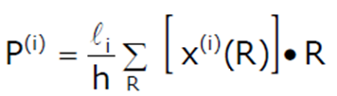
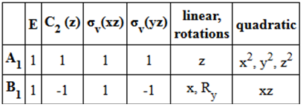
H₂O Orbital Diagram
Generate SALCs of peripheral atoms
To generate SALCs, the steps are:
group the similar AOs
generate the rep. then irr. rep. for each set
Use projection operator for one basis
z
P^{A1} = 1/4 [((1) E φ₁ ) + ((1) C₂ φ₁ ) + ((1) σ_{xz} φ₁ ) + ((1) σ_{yz} φ₁ )]
O
x
y
H
H
φ₁
φ₂
Γ_{H} =
A₁ + B₁

Slide 59
H₂O Orbital Diagram
Generate SALCs of peripheral atoms
To generate SALCs, the steps are:
group the similar AOs
generate the rep. then irr. rep. for each set
Use projection operator for one basis
z
P^{A1} = 1/4 [((1) E φ₁ ) + ((1) C₂ φ₁ ) + ((1) σ_{xz} φ₁ ) + ((1) σ_{yz} φ₁ )]
O
x
y
H
H
φ₁
φ₂
Γ_{H} =
A₁ + B₁

Slide 60
H₂O Orbital Diagram
Generate SALCs of peripheral atoms
To generate SALCs, the steps are:
group the similar AOs
generate the rep. then irr. rep. for each set
Use projection operator for one basis
z
P^{A1} = 1/4 [((1) E φ₁ ) + ((1) C₂ φ₁ ) + ((1) σ_{xz} φ₁ ) + ((1) σ_{yz} φ₁ )]
O
x
y
H
H
φ₁
φ₂
Γ_{H} =
A₁ + B₁

Slide 61
H₂O Orbital Diagram
Generate SALCs of peripheral atoms
To generate SALCs, the steps are:
group the similar AOs
generate the rep. then irr. rep. for each set
Use projection operator for one basis
z
P^{A1} = 1/4 [((1) E φ₁ ) + ((1) C₂ φ₁ ) + ((1) σ_{xz} φ₁ ) + ((1) σ_{yz} φ₁ )]
O
x
y
φ₁
φ₂
φ₁
φ₂
H
H
φ₁
φ₂
P^{A1} = 1/4 [φ₁ + φ₂ + φ₁ + φ₂]
P^{A1} = 1/4 [2φ₁ + 2φ₂]
Γ_{H} =
A₁ + B₁
P^{A1} = 1/2 [φ₁ + φ₂]
A₁ H1s orbitals

Slide 62
H₂O Orbital Diagram
Generate SALCs of peripheral atoms
To generate SALCs, the steps are:
group the similar AOs
generate the rep. then irr. rep. for each set
Use projection operator for one basis
z
P^{B1} = 1/4 [((1) E φ₁ ) + ((-1) C₂ φ₁ ) + ((1) σ_{xz} φ₁ ) + ((-1) σ_{yz} φ₁ )]
O
x
y
H
H
φ₁
φ₂
Γ_{H} =
A₁ + B₁

Slide 63
H₂O Orbital Diagram
Generate SALCs of peripheral atoms
To generate SALCs, the steps are:
group the similar AOs
generate the rep. then irr. rep. for each set
Use projection operator for one basis
z
P^{B1} = 1/4 [((1) E φ₁ ) + ((-1) C₂ φ₁ ) + ((1) σ_{xz} φ₁ ) + ((-1) σ_{yz} φ₁ )]
O
x
y
H
H
φ₁
φ₂
Γ_{H} =
A₁ + B₁

Slide 64
H₂O Orbital Diagram
Generate SALCs of peripheral atoms
To generate SALCs, the steps are:
group the similar AOs
generate the rep. then irr. rep. for each set
Use projection operator for one basis
z
P^{B1} = 1/4 [((1) E φ₁ ) + ((-1) C₂ φ₁ ) + ((1) σ_{xz} φ₁ ) + ((-1) σ_{yz} φ₁ )]
O
x
y
H
H
φ₁
φ₂
Γ_{H} =
A₁ + B₁

Slide 65
H₂O Orbital Diagram
Generate SALCs of peripheral atoms
To generate SALCs, the steps are:
group the similar AOs
generate the rep. then irr. rep. for each set
Use projection operator for one basis
z
P^{B1} = 1/4 [((1) E φ₁ ) + ((-1) C₂ φ₁ ) + ((1) σ_{xz} φ₁ ) + ((-1) σ_{yz} φ₁ )]
O
x
y
φ₁
φ₂
φ₁
φ₂
H
H
φ₁
φ₂
P^{B1} = 1/4 [φ₁ - φ₂ + φ₁ - φ₂]
P^{B1} = 1/4 [2φ₁ - 2φ₂]
Γ_{H} =
A₁ + B₁
P^{B1} = 1/2 [φ₁ - φ₂]
B₁ H1s orbitals

Slide 66
H₂O Orbital Diagram
Draw SALC with central atom.
B₁
A₁
A₁ B₁
p_{y} (B₂)
p_{z} (A₁)
p_{x} (B₁)
p_{y} (B₂)
A₁
z
B₁
O
x
y
H
H
2s (A₁)
A₁
H₂O

Slide 67
H₂O Orbital Diagram
Assign a point group
Choose basis function (orbitals)
Apply operations
-if the basis stays the same = +1
-if the basis is reversed = -1
-if it is a more complicated change = 0
Generate a reducible representation
Reduce to irreducible representation
Combine orbitals by their symmetry
Fill MOs with e⁻
Generate SALCs of peripheral atoms
Draw peripheral atoms SALC with central atom orbital to generate bonding/antibonding MOs.
B₁
A₁
A₁ B₁
p_{y} (B₂)
p_{z} (A₁)
p_{x} (B₁)
p_{y} (B₂)
A₁
B₁
2s (A₁)
A₁

Slide 68
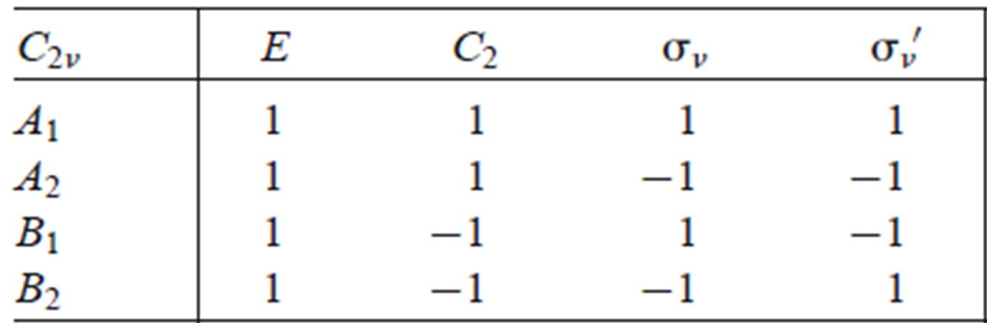




Sidenote: Many Electron States
Determining the symmetry of many electron states from the symmetry of the individual one electron wavefunctions.
Important for formulating spectroscopic selection rules between orbitals or electronic states.
State symmetry found from the direct product of all electron symmetries.
B₁
A₁
B₂
A₁
B₁
A₁
H₂O

Slide 69
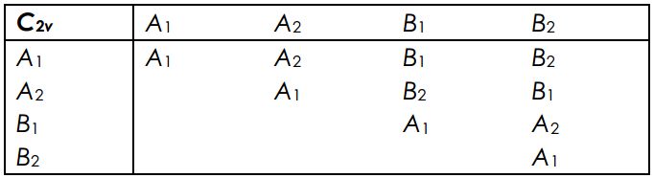
Sidenote: Many Electron States
Determining the symmetry of many electron states from the symmetry of the individual one electron wavefunctions.
Important for formulating spectroscopic selection rules between orbitals or electronic states.
State symmetry found from the direct product of all electron symmetries.
B₁
A₁
B₂
A₁
B₁
A₁
H₂O

Slide 70

Sidenote: Many Electron States
B₁
H₂O:
A₁
A₁
B₂
B₂
A₁
A₁
B₂
B₂
=
A₁
A₁
A₁
B₂
B₂
A₁
A₁
B₂
B₂
=
A₁
B₂
B₂
…etc.
or closed shell configurations cancel!
A₁
B₁
H₂O:
A₁
A₁
B₂
B₂
A₁
A₁
B₂
B₂
=
A₁
A₁
A₁
A₁
A₁
A₁
H₂O

Slide 71
Sidenote: Many Electron States
B₁
H₂O:
A₁
A₁
B₂
B₂
A₁
A₁
B₂
B₂
=
A₁
A₁
B₂
A₁
B₁
A₁
H₂O

Slide 72
Sidenote: Many Electron States
B₁
H₂O:
A₁
A₁
B₂
B₂
A₁
A₁
B₂
B₂
=
A₁
A₁
H₂O⁺:
A₁
A₁
B₂
B₂
A₁
A₁
B₂
=
B₂
B₂
A₁
B₁
A₁
H₂O⁺

Slide 73
Sidenote: Many Electron States
B₁
H₂O:
A₁
A₁
B₂
B₂
A₁
A₁
B₂
B₂
=
A₁
A₁
H₂O⁺:
A₁
A₁
B₂
B₂
A₁
A₁
B₂
=
B₂
B₂
A₁
H₂O⁻
=
A₁
B₁
A₁
H₂O⁻

Slide 74
Sidenote: Many Electron States
B₁
H₂O:
A₁
A₁
B₂
B₂
A₁
A₁
B₂
B₂
=
A₁
A₁
H₂O⁺:
A₁
A₁
B₂
B₂
A₁
A₁
B₂
=
B₂
B₂
A₁
H₂O⁻
=
A₁
B₁
H₂O*
=
B₂
A₁
H₂O*

Slide 75
Sidenote: Spin Multiplicity
H₂O
H₂O⁺
H₂O⁻
H₂O*
A₁
A₁
A₁
A₁
or
A₁
B₂
B₂
B₂
B₂
B₂
A₁
A₁
A₁
A₁
A₁
A₁
B₂
A₁
B₂
Spin Multiplicity:
^{(2s+1)}Γ_{1 or 2}
s = 0
s = 1/2
s = 1/2
s = 0
s = 1
¹A₁
²B₂
²A₁
¹B₂
³B₂

Slide 76
H₂O Orbital Diagram
Assign a point group
Choose basis function (orbitals)
Apply operations
-if the basis stays the same = +1
-if the basis is reversed = -1
-if it is a more complicated change = 0
Generate a reducible representation
Reduce to irreducible representation
Combine orbitals by their symmetry
Fill MOs with e⁻
Generate SALCs of peripheral atoms
Draw peripheral atoms SALC with central atom orbital to generate bonding/antibonding MOs.
B₁
A₁
A₁ B₁
p_{y} (B₂)
p_{z} (A₁)
p_{x} (B₁)
p_{y} (B₂)
A₁
B₁
2s (A₁)
A₁
Ground State Symmetry of H₂O is ¹A₁

Slide 77
MO Diagrams from Group Theory
H-F
diatomic, H = 1s; F = 2s, 3 x 2p
H₂O
triatomic, H = 2 x 1s; O = 2s, 3 x 2p
CO₂
π bonding, O = 2s, 3 x 2p; C = 2s, 3 x 2p
C₂H₄
Fragmentation method
NH₃/Benzene
Real + Imaginary SALC

Slide 78
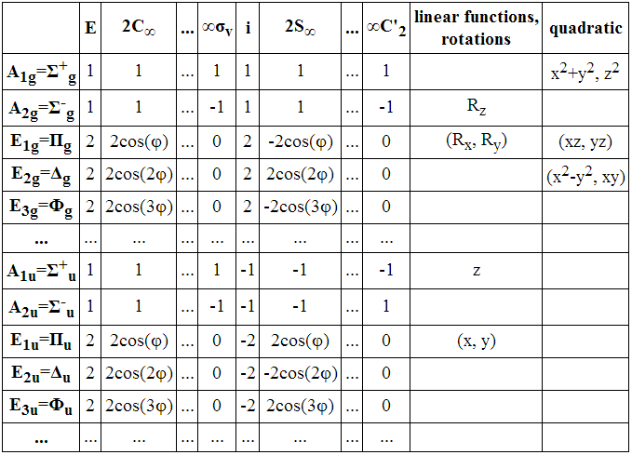
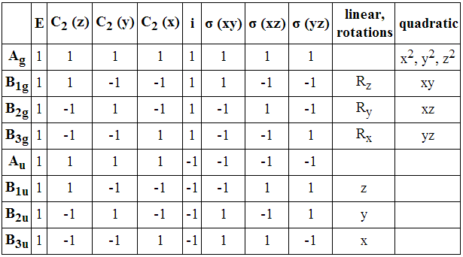
CO₂ Orbital Diagram
Assign a point group
CO₂
D_{2h}
D_{∞h}
D_{2h}

Slide 79
CO₂ Orbital Diagram
Assign a point group
Choose basis function (orbitals)
CO₂
D_{2h}
C s, p_{x}, p_{y} and p_{z} orbitals
O p_{x}, p_{y} and p_{z} orbitals

Slide 80
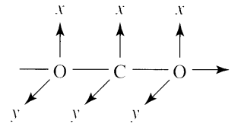
CO₂ Orbital Diagram
Assign a point group
Choose basis function (orbitals)
Apply operations
-if the basis stays the same = +1
-if the basis is reversed = -1
-if it is a more complicated change = 0
CO₂
D_{2h}
C s, p_{x}, p_{y} and p_{z} orbitals
O p_{x}, p_{y} and p_{z} orbitals
z

Slide 81
CO₂ Orbital Diagram
Assign a point group
Choose basis function (orbitals)
Apply operations
-if the basis stays the same = +1
-if the basis is reversed = -1
-if it is a more complicated change = 0
CO₂
D_{2h}
A_{g}
B_{3u}
B_{2u}
B_{1u}
C s, p_{x}, p_{y} and p_{z} orbitals
O p_{x}, p_{y} and p_{z} orbitals
z

Slide 82
CO₂ Orbital Diagram
Assign a point group
Choose basis function (orbitals)
Apply operations
-if the basis stays the same = +1
-if the basis is reversed = -1
-if it is a more complicated change = 0
CO₂
D_{2h}
A_{g}
B_{3u}
B_{2u}
B_{1u}
C s, p_{x}, p_{y} and p_{z} orbitals
O p_{x}, p_{y} and p_{z} orbitals
z
2
2
0
0
0
0
2
2
Γ_{Opz}
Γ_{Opz}
A_{g} + B_{1u}

Slide 83
CO₂ Orbital Diagram
Assign a point group
Choose basis function (orbitals)
Apply operations
-if the basis stays the same = +1
-if the basis is reversed = -1
-if it is a more complicated change = 0
CO₂
D_{2h}
A_{g}
B_{3u}
B_{2u}
B_{1u}
C s, p_{x}, p_{y} and p_{z} orbitals
O p_{x}, p_{y} and p_{z} orbitals
z
2
-2
0
0
0
0
2
-2
Γ_{Opx}
Γ_{Opx}
B_{3u} + B_{2g}

Slide 84
CO₂ Orbital Diagram
Assign a point group
Choose basis function (orbitals)
Apply operations
-if the basis stays the same = +1
-if the basis is reversed = -1
-if it is a more complicated change = 0
CO₂
D_{2h}
A_{g}
B_{3u}
B_{2u}
B_{1u}
C s, p_{x}, p_{y} and p_{z} orbitals
O p_{x}, p_{y} and p_{z} orbitals
z
2
-2
0
0
0
0
-2
2
Γ_{Opy}
Γ_{Opy}
B_{2u} + B_{3g}

Slide 85
CO₂ Orbital Diagram
Assign a point group
Choose basis function (orbitals)
Apply operations
-if the basis stays the same = +1
-if the basis is reversed = -1
-if it is a more complicated change = 0
Generate a reducible representation
Reduce to irreducible representation
Combine orbitals by their symmetry
CO₂
D_{2h}
A_{g}
B_{3u}
B_{2u}
B_{1u}
C s, p_{x}, p_{y} and p_{z} orbitals
O p_{x}
p_{y}
p_{z}
B_{3u} + B_{2g}
B_{2u} + B_{3g}
A_{g} + B_{1u}

Slide 86
CO₂ Orbital Diagram
Combine orbitals by their symmetry
C s, p_{x}, p_{y} and p_{z} orbitals
O p_{x}, p_{y} and p_{z} orbitals

Slide 87
CO₂ Orbital Diagram
Combine orbitals by their symmetry
B_{1u}
A_{g}
p_{x}
p_{y}
p_{z}
B_{3u}
B_{2u}
2p
B_{3u}
B_{2u}
B_{1u}
p_{x}
p_{y}
p_{z}
B_{2g}
B_{3g}
B_{2g}
B_{3g}
B_{1u}
2p
B_{3u}
B_{2u}
A_{g}
B_{3u}
B_{2u}
2s
B_{1u}
A_{g}
A_{g}
C
OCO
2 x O

Slide 88
CO₂ Orbital Diagram
B_{1u}
Assign a point group
Choose basis function (orbitals)
Apply operations
-if the basis stays the same = +1
-if the basis is reversed = -1
-if it is a more complicated change = 0
Generate a reducible representation
Reduce to irreducible representation
Combine orbitals by their symmetry
Fill MOs with e⁻
A_{g}
p_{x}
p_{y}
p_{z}
B_{3u}
B_{2u}
2p
B_{3u}
B_{2u}
B_{1u}
p_{x}
p_{y}
p_{z}
B_{2g}
B_{3g}
B_{2g}
B_{3g}
B_{1u}
2p
B_{3u}
B_{2u}
A_{g}
B_{3u}
B_{2u}
2s
B_{1u}
A_{g}
A_{g}
C
OCO
2 x O

Slide 89
CO₂ Orbital Diagram
Fill MOs with e⁻
B_{1u}
A_{g}
p_{x}
p_{y}
p_{z}
B_{3u}
B_{2u}
2p
B_{3u}
B_{2u}
B_{1u}
p_{x}
p_{y}
p_{z}
B_{2g}
B_{3g}
B_{2g}
B_{3g}
B_{1u}
2p
B_{3u}
B_{2u}
A_{g}
B_{3u}
B_{2u}
2s
B_{1u}
A_{g}
A_{g}
4 e⁻
C
OCO
2 x O
8 e⁻

Slide 90
CO₂ Orbital Diagram
B_{1u}
Assign a point group
Choose basis function (orbitals)
Apply operations
-if the basis stays the same = +1
-if the basis is reversed = -1
-if it is a more complicated change = 0
Generate a reducible representation
Reduce to irreducible representation
Combine orbitals by their symmetry
Fill MOs with e⁻
Generate SALCs of peripheral atoms
Draw peripheral atoms SALC with central atom orbital to generate bonding/antibonding MOs.
A_{g}
p_{x}
p_{y}
p_{z}
B_{3u}
B_{2u}
2p
B_{3u}
B_{2u}
B_{1u}
p_{x}
p_{y}
p_{z}
B_{2g}
B_{3g}
B_{2g}
B_{3g}
B_{1u}
2p
B_{3u}
B_{2u}
A_{g}
B_{3u}
B_{2u}
2s
B_{1u}
A_{g}
A_{g}
C
OCO
2 x O

Slide 91
CO₂ Orbital Diagram
Generate SALCs of peripheral atoms
φ₂
φ₁
z
Γ_{Opz}
A_{g} + B_{1u}
P^{Ag} = 1/8 [((1) E φ₁ ) + ((1) C₂ φ₁ ) + ((1) C₂ φ₁ ) … etc.]
P^{Ag} = 1/8 [4φ₁ + 4φ₂]

Slide 92
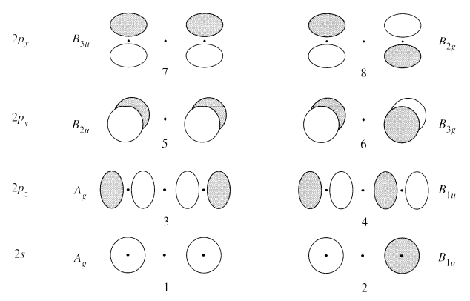
CO₂ Orbital Diagram
Generate SALCs of peripheral atoms
z

Slide 93
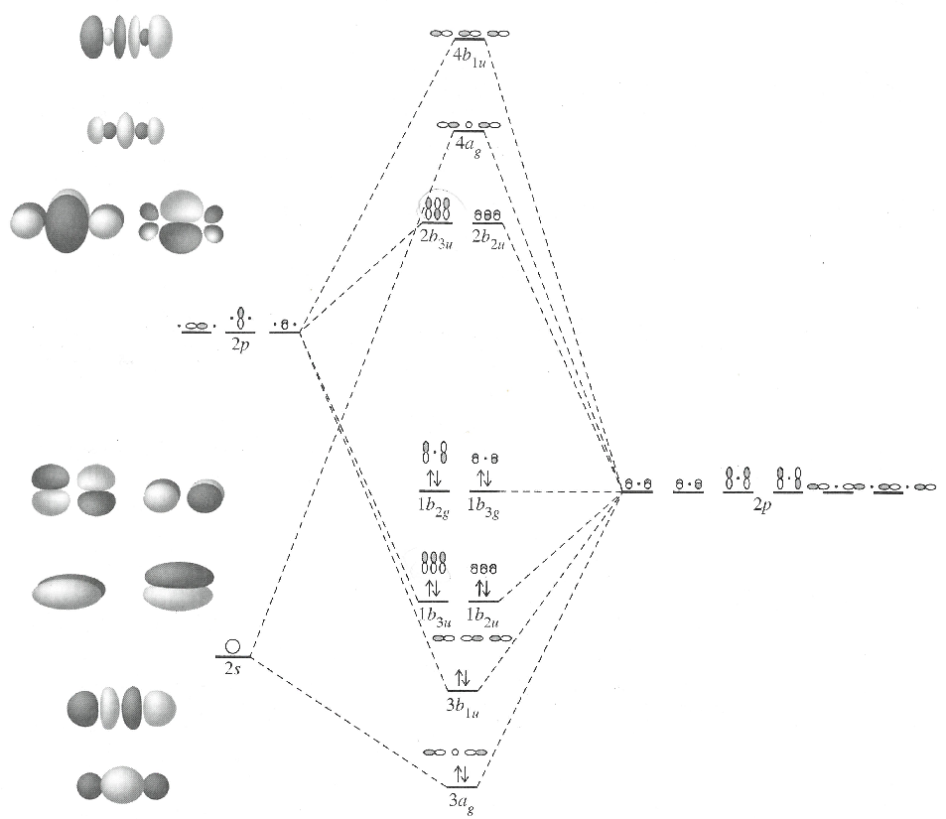
CO₂ Orbital Diagram
Draw SALC with central atom.
C
OCO
2 x O

Slide 94
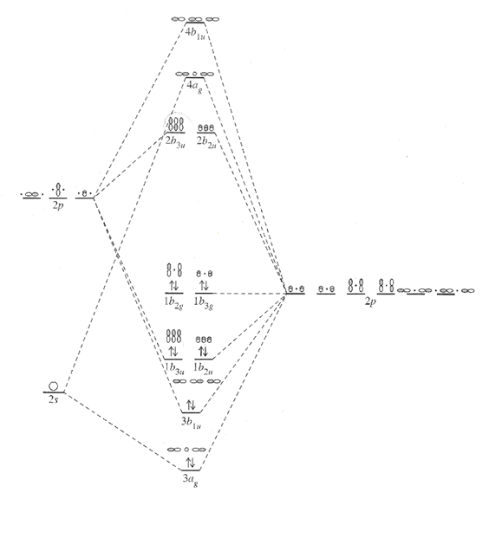
CO₂ Orbital Diagram
Assign a point group
Choose basis function (orbitals)
Apply operations
-if the basis stays the same = +1
-if the basis is reversed = -1
-if it is a more complicated change = 0
Generate a reducible representation
Reduce to irreducible representation
Combine orbitals by their symmetry
Fill MOs with e⁻
Generate SALCs of peripheral atoms
Draw peripheral atoms SALC with central atom orbital to generate bonding/antibonding MOs.

Slide 95
MO Diagrams from Group Theory
H-F
diatomic, H = 1s; F = 2s, 3 x 2p
H₂O
triatomic, H = 2 x 1s; O = 2s, 3 x 2p
CO₂
π bonding, O = 2s, 3 x 2p; C = 2s, 3 x 2p
C₂H₄
Fragmentation method
NH₃/Benzene
Real + Imaginary SALC

Slide 96
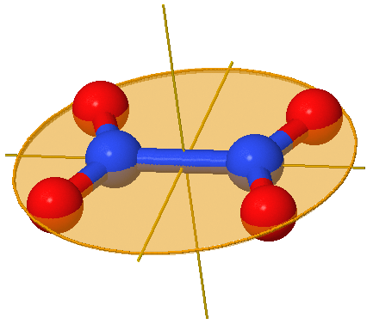
Ethene Orbital Diagram
x
z
y
Two different approaches (D_{2h})
C₁ + C₂
H₁₋₄
then combine
CH₂
then combine
J. Chem. Edu. 2004, 81, 997

Slide 97

Ethene Orbital Diagram

Slide 98

Ethene Orbital Diagram

Slide 99

Ethene Orbital Diagram

Slide 100
MO Diagrams from Group Theory
H-F
diatomic, H = 1s; F = 2s, 3 x 2p
H₂O
triatomic, H = 2 x 1s; O = 2s, 3 x 2p
CO₂
π bonding, O = 2s, 3 x 2p; C = 2s, 3 x 2p
C₂H₄
Fragmentation method
NH₃/Benzene
Real + Imaginary SALC

Slide 101

NH₃ Orbital Diagram
Assign a point group
Choose basis function (orbitals)
Apply operations
-if the basis stays the same = +1
-if the basis is reversed = -1
-if it is a more complicated change = 0
NH₂
C_{3v}
A₁ + E
H s orbitals
N s, p_{x}, p_{y} and p_{z} orbitals
z
x
y
Γ_{H}
3
0
1
Γ_{H}
A₁ + E

Slide 102
NH₃ Orbital Diagram
Assign a point group
Choose basis function (orbitals)
Apply operations
-if the basis stays the same = +1
-if the basis is reversed = -1
-if it is a more complicated change = 0
NH₂
C_{3v}
A₁ + E
H s orbitals
N s, p_{x}, p_{y} and p_{z} orbitals
A₁
E
A₁
z
x
y

Slide 103
NH₃ Orbital Diagram
Combine orbitals by their symmetry
H s orbital
N s, p_{x}, p_{y} and p_{z} orbitals

Slide 104
NH₃ Orbital Diagram
Combine orbitals by their symmetry
A₁
E
p_{z} (A₁)
p_{y}, p_{x} (E)
A₁
E
A₁
E
s (A₁)
A₁
3 x H
NH₃
N

Slide 105
NH₃ Orbital Diagram
Fill MOs with e⁻
A₁
E
p_{z} (A₁)
p_{y}, p_{x} (E)
A₁
E
A₁
E
s (A₁)
A₁
3 e⁻
3 x H
NH₃
N
5 e⁻

Slide 106
NH₃ Orbital Diagram
Assign a point group
Choose basis function (orbitals)
Apply operations
-if the basis stays the same = +1
-if the basis is reversed = -1
-if it is a more complicated change = 0
Generate a reducible representation
Reduce to irreducible representation
Combine orbitals by their symmetry
Fill MOs with e⁻
Generate SALCs of peripheral atoms
Draw peripheral atoms SALC with central atom orbital to generate bonding/antibonding MOs.
A₁
E
p_{z} (A₁)
p_{y}, p_{x} (E)
A₁
E
A₁
E
s (A₁)
A₁

Slide 107
NH₃ Orbital Diagram
Generate SALCs of peripheral atoms
To generate SALCs, the steps are:
group the atomic orbitals in the molecule into sets which are equivalent by symmetry
generate the rep. then irr. rep. for each set
Use projection operator for one basis
z
φ₃
x
φ₂
φ₁
y
Γ_{H} =
A₁ + E

Slide 108

NH₃ Orbital Diagram
Generate SALCs of peripheral atoms
Separate classes

Slide 109

NH₃ Orbital Diagram
Generate SALCs of peripheral atoms
z
φ₃
x
φ₂
φ₁
y

Slide 110
NH₃ Orbital Diagram
Generate SALCs of peripheral atoms
P^{A1} ≈ ((1) E φ₁ ) + ((1) C₃⁺φ₁ ) + ((1) C₃⁻φ₁ ) + ((1) σ₁ φ₁ ) + ((1) σ₂ φ₁ ) + ((1) σ₂ φ₁ )
φ₁
φ₂
φ₃
φ₁
φ₃
φ₂
P^{A1} ≈ [φ₁ + φ₂ + φ₃ + φ₁ + φ₃ + φ₂ ]
A₁ H1s orbitals
φ₃
P^{A1} ≈ [ 2φ₁ + 2φ₂ + 2φ₃]
P^{A1} ≈ [ φ₁ + φ₂ + φ₃]
φ₂
φ₁

Slide 111
NH₃ Orbital Diagram
Generate SALCs of peripheral atoms
P^{E} ≈ ((2) E φ₁ ) + ((-1) C₃⁺φ₁ ) + ((-1) C₃⁻φ₁ ) + ((0) σ₁ φ₁ ) + ((0) σ₂ φ₁ ) + ((0) σ₂ φ₁ )
φ₁
φ₂
φ₃
0
0
0
P^{A1} ≈ [2φ₁ - φ₂ - φ₃]
One of the E orbitals
φ₃
What about the other E orbital?
φ₂
φ₁

Slide 112


NH₃ Orbital Diagram
Generate SALCs of peripheral atoms

Slide 113


NH₃ Orbital Diagram
Generate SALCs of peripheral atoms
3 different E SALCS have been generated but they are all similar.
Use subtraction or addition to generate new SALC.
φ₃
φ₃
φ₂
φ₁
φ₂
φ₁

Slide 114
NH₃ Orbital Diagram
Draw SALC with central atom.
A₁
E
p_{z} (A₁)
p_{y}, p_{x} (E)
A₁
E
A₁
E
s (A₁)
A₁
3 x H
NH₃
N

Slide 115

NH₃ Orbital Diagram
Draw SALC with central atom.
N
3 x H

Slide 116
NH₃ Orbital Diagram
Assign a point group
Choose basis function (orbitals)
Apply operations
-if the basis stays the same = +1
-if the basis is reversed = -1
-if it is a more complicated change = 0
Generate a reducible representation
Reduce to irreducible representation
Combine orbitals by their symmetry
Fill MOs with e⁻
Generate SALCs of peripheral atoms
Draw peripheral atoms SALC with central atom orbital to generate bonding/antibonding MOs.

Slide 117
MO Diagrams from Group Theory
H-F
diatomic, H = 1s; F = 2s, 3 x 2p
H₂O
triatomic, H = 2 x 1s; O = 2s, 3 x 2p
CO₂
π bonding, O = 2s, 3 x 2p; C = 2s, 3 x 2p
C₂H₄
Fragmentation method
NH₃/Benzene
Real + Imaginary SALC

Slide 118


Benzene MOs and SALC
3 nodes
2 nodes
1 node
0 nodes

Slide 119

C₆H₆ Orbital Diagram
Assign a point group
Choose basis function (orbitals)
C₆H₆
D_{6h}
only π bonding
C p_{z} orbitals

Slide 120
C₆H₆ Orbital Diagram
Assign a point group
Choose basis function (orbitals)
Apply operations
-if the basis stays the same = +1
-if the basis is reversed = -1
-if it is a more complicated change = 0
C₆H₆
D_{6h}
only π bonding
C p_{z} orbitals
C₆
C″₂
C′₂
z axis
D_{6h} | E | 2C₆ | 2C₃ | C₂ | 3C′₂ | 3C″₂ | i | 2S₃ | 2S₆ | σ_{h} | 3 σ_{d} | 3 σ_{v}
Г_{π}
6
0
0
0
-2
0
0
0
0
-6
0
2

Slide 121
C₆H₆ Orbital Diagram
Assign a point group
Choose basis function (orbitals)
Apply operations
-if the basis stays the same = +1
-if the basis is reversed = -1
-if it is a more complicated change = 0
Generate a reducible representation
Reduce to irreducible representation
C₆H₆
D_{6h}
only π bonding
C p_{z} orbitals
C₆
C″₂
C′₂
z axis
D_{6h} | E | 2C₆ | 2C₃ | C₂ | 3C′₂ | 3C″₂ | i | 2S₃ | 2S₆ | σ_{h} | 3 σ_{d} | 3 σ_{v}
Г_{π}
6
0
0
0
-2
0
0
0
0
-6
0
2
Γ_{π}: B_{2g} + E_{1g} + A_{2u} + E_{2u}

Slide 122
C₆H₆ Orbital Diagram
Assign a point group
Choose basis function (orbitals)
Apply operations
-if the basis stays the same = +1
-if the basis is reversed = -1
-if it is a more complicated change = 0
Generate a reducible representation
Reduce to irreducible representation
Combine orbitals by their symmetry
C₆H₆
D_{6h}
only π bonding
C p_{z} orbitals
C₆
C″₂
C′₂
D_{6h} | E | 2C₆ | 2C₃ | C₂ | 3C′₂ | 3C″₂ | i | 2S₃ | 2S₆ | σ_{h} | 3 σ_{d} | 3 σ_{v}
Г_{π} | 6 | 0 | 0 | 0 | -2 | 0 | 0 | 0 | 0 | -6 | 0 | 2
Γ_{π}: B_{2g} + E_{1g} + A_{2u} + E_{2u}

Slide 123
C₆H₆ Orbital Diagram
Combine orbitals by their symmetry
B_{2g}
E_{2u}
E_{1g}
A_{2u}

Slide 124
C₆H₆ Orbital Diagram
Fill MOs with e⁻
B_{2g}
E_{2u}
E_{1g}
A_{2u}
6 p_{z} orbitals = 6 e⁻

Slide 125
C₆H₆ Orbital Diagram
Assign a point group
Choose basis function (orbitals)
Apply operations
-if the basis stays the same = +1
-if the basis is reversed = -1
-if it is a more complicated change = 0
Generate a reducible representation
Reduce to irreducible representation
Combine orbitals by their symmetry
Fill MOs with e⁻
Generate SALCs of peripheral atoms
Draw peripheral atoms SALC with central atom orbital to generate bonding/antibonding MOs.
C₆H₆
D_{6h}
only π bonding
C p_{z} orbitals
Γ_{π}: B_{2g} + E_{1g} + A_{2u} + E_{2u}

Slide 126



C₆H₆ Orbital Diagram
Generate SALCs of peripheral atoms
Simplify usingC₆!
D_{6h}
C₆

Slide 127




C₆H₆ Orbital Diagram
Generate SALCs of peripheral atoms
Simplify usingC₆!
D_{6h}
C₆

Slide 128










C₆H₆ Orbital Diagram
Generate SALCs of peripheral atoms
To generate SALCs, the steps are:
group the similar AOs
generate the rep. then irr. rep. for each set
Use projection operator for one basis
A orbital

Slide 129
C₆H₆ Orbital Diagram
Generate SALCs of peripheral atoms
To generate SALCs, the steps are:
group the similar AOs
generate the rep. then irr. rep. for each set
Use projection operator for one basis

Slide 130



C₆H₆ Orbital Diagram
Generate SALCs of peripheral atoms
To generate SALCs, the steps are:
group the similar AOs
generate the rep. then irr. rep. for each set
Use projection operator for one basis
B orbital

Slide 131

C₆H₆ Orbital Diagram
Generate SALCs of peripheral atoms
B ≈ B_{2g}
B
E₂
E₁
A ≈ A_{2u}
A

Slide 132


C₆H₆ Orbital Diagram
Generate SALCs of peripheral atoms
To generate SALCs, the steps are:
group the similar AOs
generate the rep. then irr. rep. for each set
Use projection operator for one basis
ok
ok
What?

Slide 133


C₆H₆ Orbital Diagram
Contain imaginary components; the real component of the linear combination may be realized by taking ± linear combinations:

Slide 134



C₆H₆ Orbital Diagram
Contain imaginary components; the real component of the linear combination may be realized by taking ± linear combinations:
For C₆ point group:
or from Euler’s formula

Slide 135



C₆H₆ Orbital Diagram
Contain imaginary components; the real component of the linear combination may be realized by taking ± linear combinations:
divide out and remove prefactor constant (-i√3)

Slide 136




C₆H₆ Orbital Diagram
What are the pictorial representation of the SALC’s?

Slide 137



C₆H₆ Orbital Diagram
What are the pictorial representation of the SALC’s?

Slide 138
Projection Operator: Benzene
What are the pictorial representation of the SALC’s?
3 nodes
2 nodes
1 node
0 nodes

Slide 139
Orbital Diagrams
Orbital Interactions
Molecular Orbital Theory
Orbital Energies
MO Diagrams
HF, H₂O, CO₂, C₂H₄, NH₃, Benzene
SALC
Hybridization
Symmetry and Reactivity

Slide 140
MO Diagrams from Group Theory
H-F
diatomic, H = 1s; F = 2s, 3 x 2p
H₂O
triatomic, H = 2 x 1s; O = 2s, 3 x 2p
CO₂
π bonding, O = 2s, 3 x 2p; C = 2s, 3 x 2p
C₂H₄
Fragmentation method
NH₃/Benzene
Real + Imaginary SALC

Slide 141



Side Note: Orbital Hybridization
In chemistry, hybridization is the concept of mixing atomic orbitals into new hybrid orbitals (with different energies, shapes, etc., than the component atomic orbitals) suitable for the pairing of electrons to form chemical bonds.
H
C

Slide 142
s + p Hybrid Orbitals
Miessler and Tarr, Inorganic Chemistry

Slide 143
s + p + d Hybrid Orbitals

Slide 144


BF₃ Hybridization
Steps to determine the hybridization of a bond.
BF₃
Assign a point group
Choose basis function (σ bonds)
Apply operations
-if the basis stays the same = +1
-if the basis is reversed = -1
-if it is a more complicated change = 0
D_{3h}
σ bonds
D_{3h}
Г_{σ}
3 0 1 3 0 1

Slide 145

BF₃ Hybridization
Steps to determine the hybridization of a bond.
BF₃
Reduce to irreducible representation
D_{3h}
σ bonds
Г_{σ}
3 0 1 3 0 1
Γ_{σ}: A₁’ + E’

Slide 146
BF₃ Hybridization
Steps to determine the hybridization of a bond.
Compare symmetry of irr. rep. to central atom MOs
BF₃
D_{3h}
B (s) = A₁’
B (p_{x})= E’
B (p_{y})= E’
B (p_{z})= A₂”
Γ_{σ}: A₁’ + E’

Slide 147

BF₃ Hybridization
Steps to determine the hybridization of a bond.
Compare symmetry of irr. rep. to central atom MOs
z
z
z
z
z
y
y
y
y
y
y
x
x
x
x
x
Γ_{σ}: A₁’ + E’
s = A₁’
p_{x} = E’
p_{y} = E’
p_{z} = A₂”
sp² hybridization (s, p_{x}, p_{y})

Slide 148
Orbital Diagrams
Orbital Interactions
Molecular Orbital Theory
Orbital Energies
MO Diagrams
HF, H₂O, CO₂, C₂H₄, NH₃, Benzene
SALC
Hybridization
Symmetry and Reactivity

Slide 149

Hybridization
Steps to determine the hybridization of a bond.
Assign a point group
Choose basis function (σ bonds)
Apply operations
-if the basis stays the same = +1
-if the basis is reversed = -1
-if it is a more complicated change = 0
Generate a reducible representation
Reduce to irreducible representation
Compare symmetry of irr. rep. to central atom MOs

Slide 150


Symmetry and Reactivity
(2 + 2) cycloaddition
2 x ethylene
cyclobutane
π orbitals
σ bonds
Orbital symmetry is retained during the reaction!

Slide 151

Symmetry and Reactivity
(2 + 2) cycloaddition

Slide 152

Symmetry and Reactivity
Thermal Reaction
Photo Reaction
2 bonding + 2 antibonding e⁻
Thermally Forbidden
(~115 kcal/mol)
3 bonding + 1 antibonding e⁻
Photochemically Allowed

Slide 153
Orbital Diagrams
Orbital Interactions
Molecular Orbital Theory
Orbital Energies
MO Diagrams
HF, H₂O, CO₂, C₂H₄, NH₃, Benzene
SALC
Hybridization
Symmetry and Reactivity

